Slide 1
Avoiding Dependencies
SOLID Foundations
David Sackstein, CodePrecise

Slide 2
Agenda
The SOLID Design Principles
Dependency Injection
Good Inheritance – Bad Inheritance
The Decorator Design Pattern
The Visitor Design Pattern

Slide 3
The SOLID Design Principles
S | Single Responsibility Principle
O | Open Closed Principle
L | Liskov’s Substitution Principle
I | Interface Segregration Principle
D | Dependency Inversion Principles

Slide 4

The SOLID Design Principles
S The Single Responsibility Principle
Any class should have only one reason to change.
All rights reserved

Slide 5
The SOLID Design Principles (cont)
O The Open Closed Principle:
Designs should be open for extension and closed for change.
L The Liskov Substitution Principle:
Derived types must be substitutable for base types.
All rights reserved

Slide 6
The SOLID Design Principles (cont)
I The Interface Segregation Principle:
Clients should not be forced to depend upon interfaces that they don't use.
D The Dependency Inversion Principle:
High-level modules should not depend on low-level modules. All modules should depend on abstractions.
All rights reserved

Slide 7
How are Dependencies Acquired?
If a class creates the classes it needs:
  The class cannot be tested without that type
  The class cannot be extended, to support other implementations of that type (OCP violation)
Two common methods exist:
  Service Locator
  Dependency Injection (preferred)

Slide 8
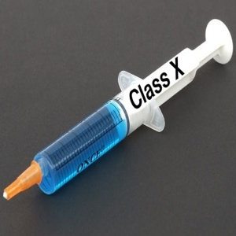
Dependency Injection
A software design pattern that allows a choice of component to be made at run-time rather than compile time.
Classes declare what they need.
Three methods:
  Constructor Injection
  Setter injection
  Interface injection

Slide 9
IOC Containers
Implement Dependency Injection automatically.
Allows developers to separate the code that wires up the dependencies and the code that implements the system’s run time functions
IOC containers recursively resolve dependencies using registered types and mappings.

Slide 10
IOC Frameworks for .NET
Castle http://www.castleproject.org/container/index.html
Spring.NET
http://www.springframework.net/
Unity
http://unity.codeplex.com/
MEF
http://msdn.microsoft.com/en-us/library/dd460648.aspx

Slide 11
Good Inheritance Bad Inheritance
Our objective: Reduce dependencies
Inheritance for “Code Reuse” is bad
Inheritance for “Contract Reuse” is good
A refactoring method to break dependencies

Slide 12
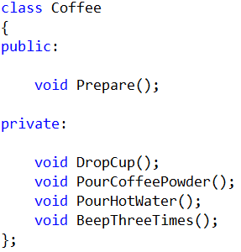
Example: Bad Inheritance

Slide 13
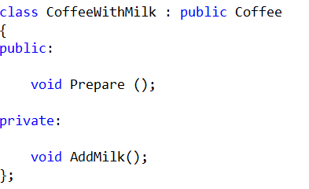
Code Reuse By Inheritance

Slide 14
This Introduced Dependencies
CoffeeWithMilk depends on Coffee
Users of CoffeeWithMilk must include Coffee.h
CoffeeWithMilk cannot be tested with an alternative implementation of Coffee
Changes to Coffee may break CoffeeWithMilk

Slide 15
Good Inheritance
Inheritance of contracts is good inheritance.
Inheritance of contracts breaks the dependence between the user of the contract and its implementer
This is Polymorphism

Slide 16
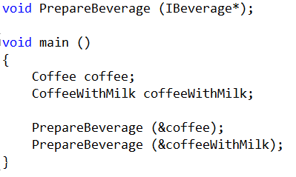
Polymorphism
PrepareBeverage uses both objects
But depends only on IBeverage

Slide 17
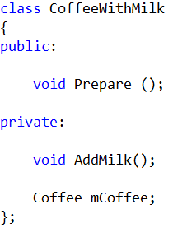
Favor Composition over Inheritance
Step 1:
Favor composition over inheritance for code reuse

Slide 18
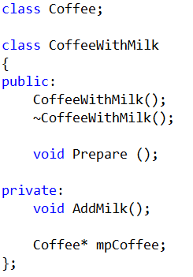
Leveraging Composition
Step 2:
Forward declaration of Coffee breaks the dependence of users on Coffee.
Users do not need to include Coffee.h

Slide 19
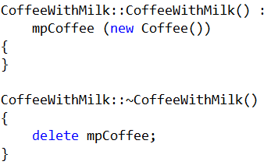
Still Room for Improvement
CoffeeWithMilk still depends on Coffee
Cannot replace Coffee with a mock

Slide 20
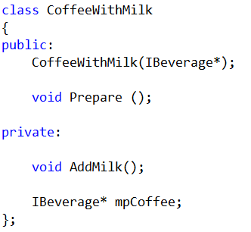
Extract Interface
Step 3
Extract interface for Coffee => no dependence on Coffee

Slide 21
Dependency Injection
Step 4
Injected interface in constructor => may test with mock

Slide 22
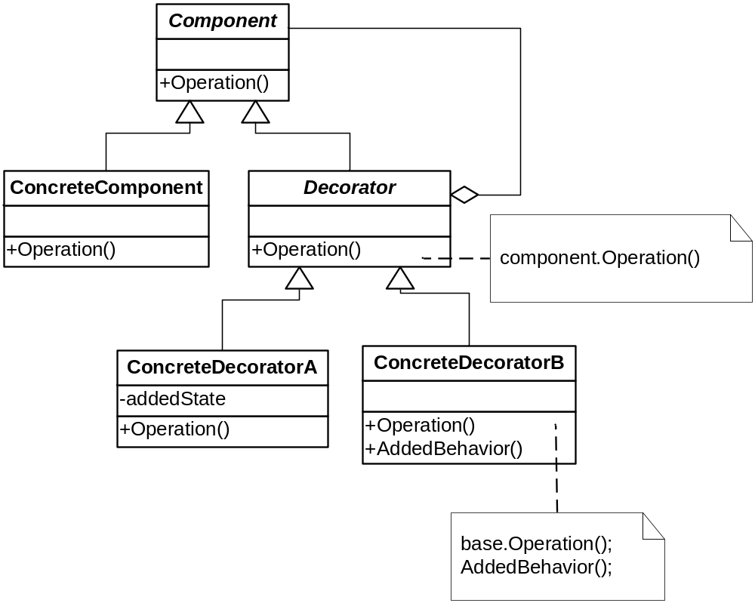
Decorator : Dynamic Inheritance
Attach additional responsibilities to an object dynamically. Decorators provide a flexible alternative to subclassing for extending functionality.
All rights reserved
Notes:
Decorator provides a an alternative to subclassing.
Inheritance is one way of extension, but not necessarily the best.
Composition and delegation offer run-time extension.
Our designs should allow behavior to be extended without requiring change.
Decorator classes mirror the type of the components they decorate.
You can wrap a component with any number of decorators.
Decorators can result in many small objects in our design, and overuse can be complex.

Slide 23
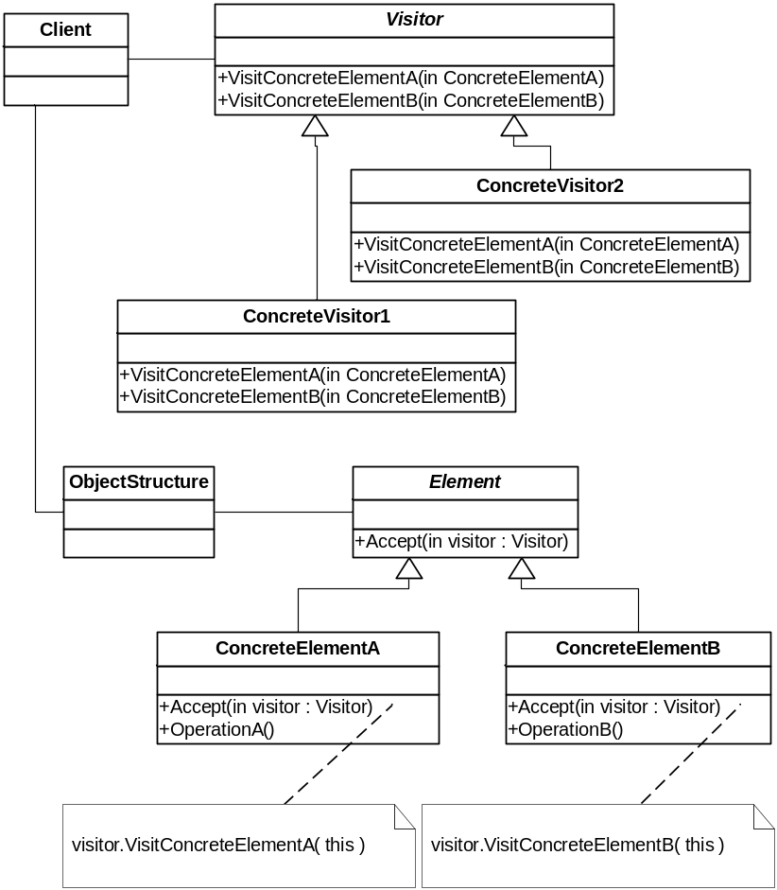
Visitor: Open Closed Principle
Represent an operation to be performed on the elements of an object structure. Visitor lets you define a new operation without changing the classes of the elements on which it operates.
All rights reserved

